Slide 1
Stimuli

Slide 2
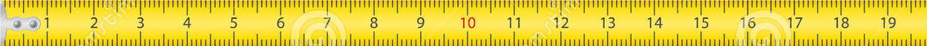

Slide 3
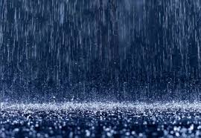
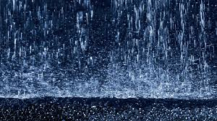
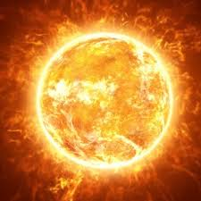
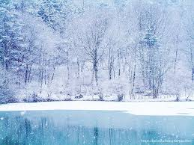
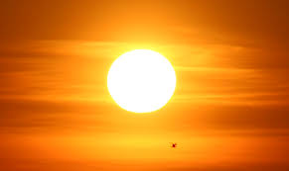
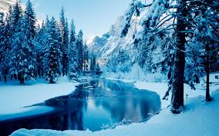
Instructions
In addition, the aliens’ planet goes through different seasons, and aliens will need different things depending on these seasons!
For example, one alien might need to swim in a mud puddle in the hot season, but it needs to sleep in a bed during the rainy season in order to grow.

Slide 4


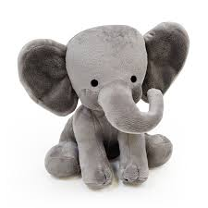
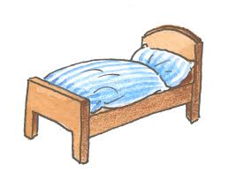
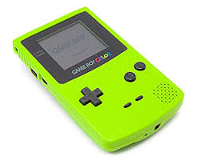

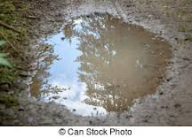
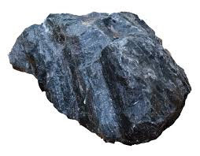
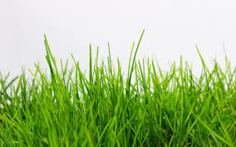

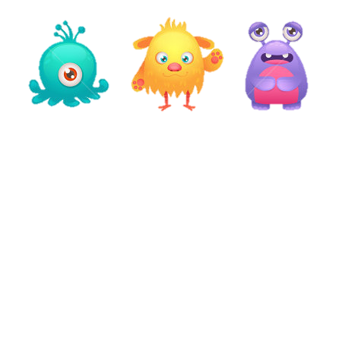

Slide 5

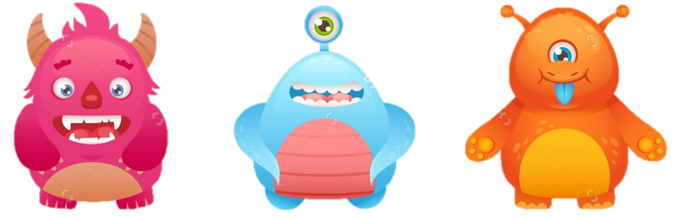

Slide 6
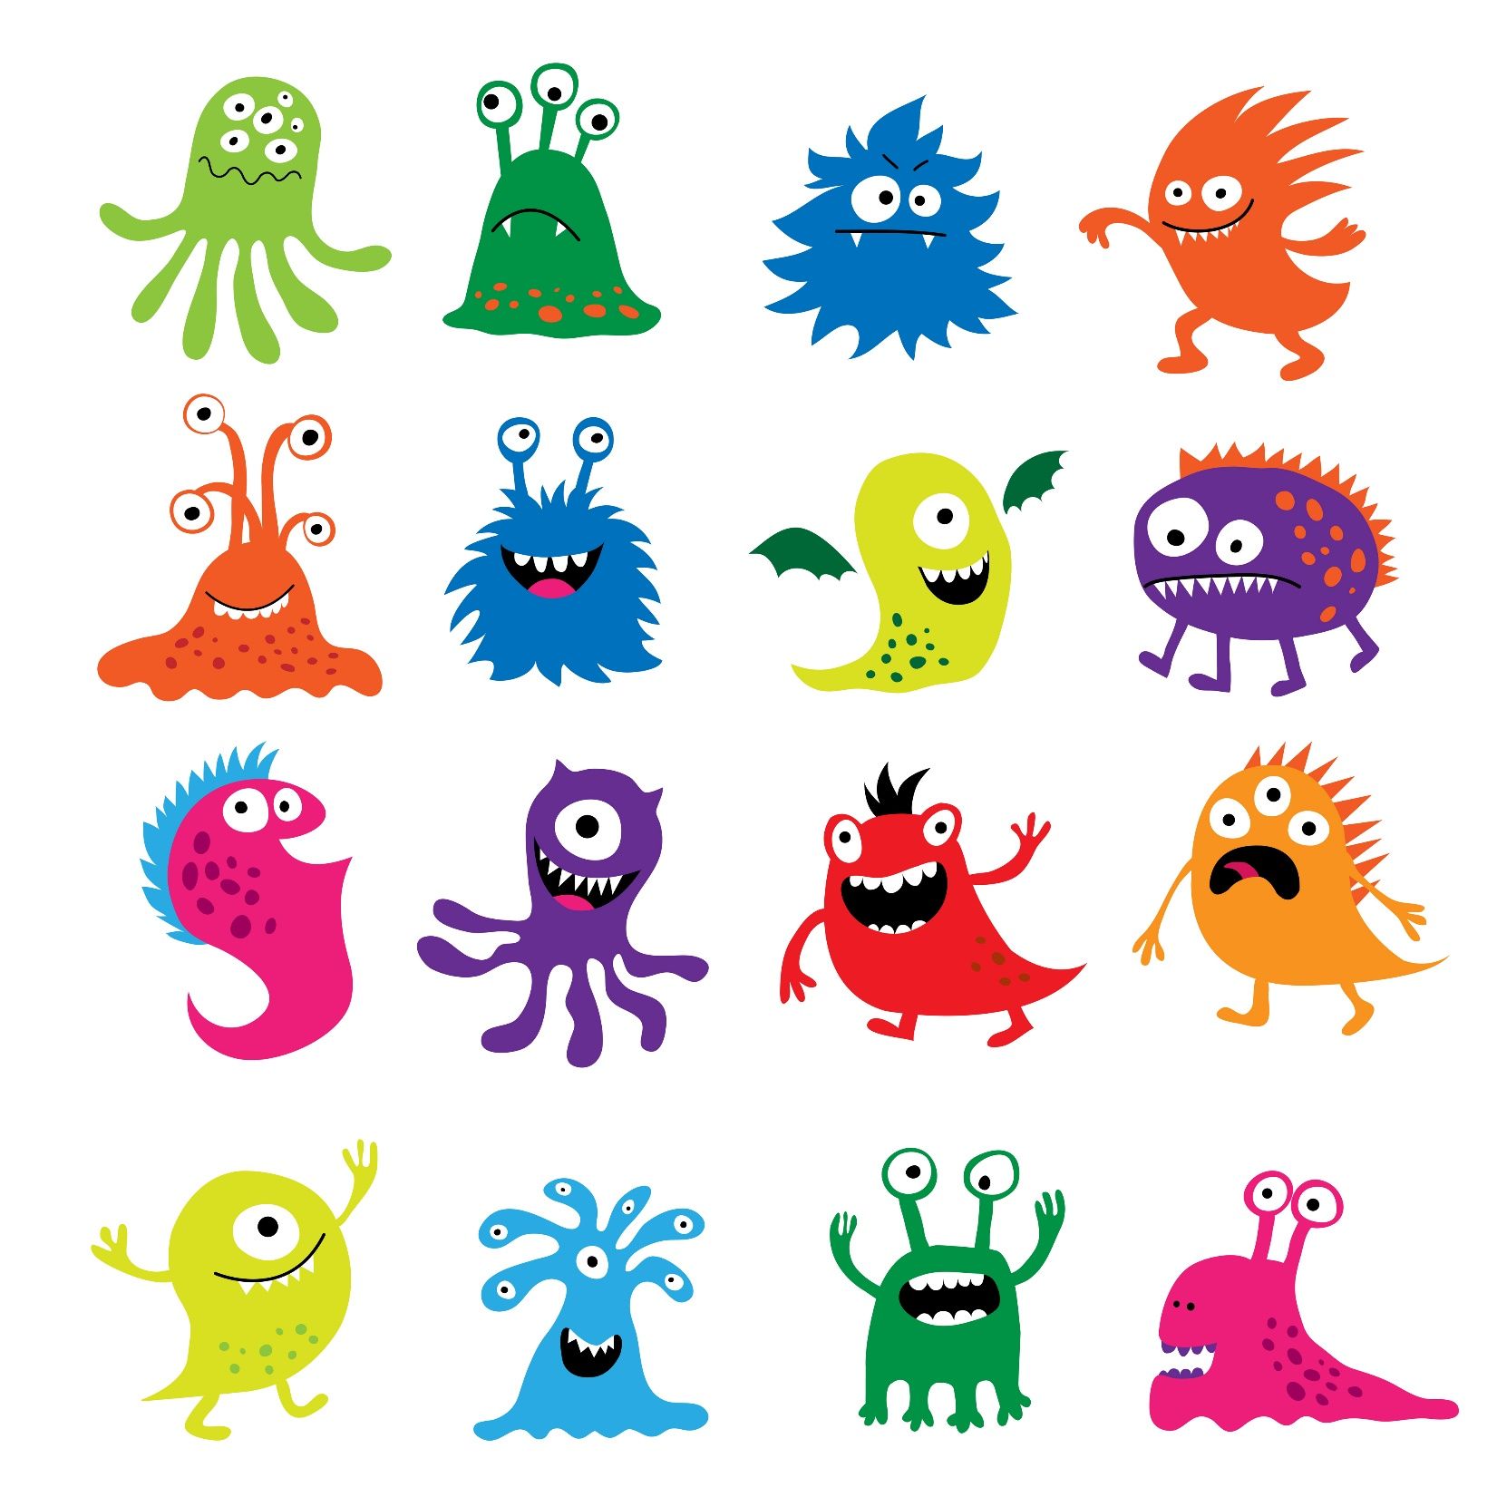


Slide 7


Slide 8
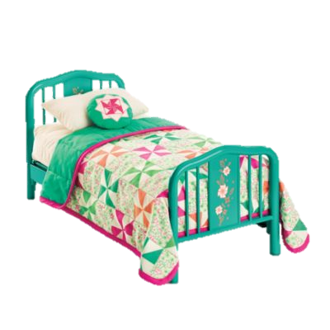
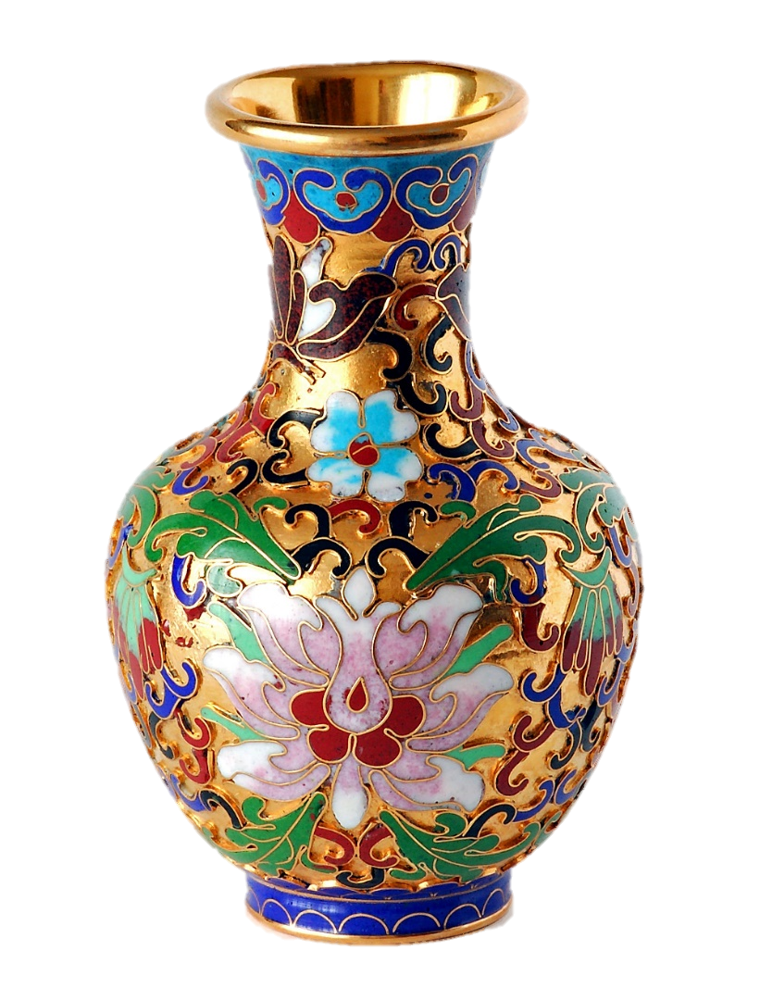

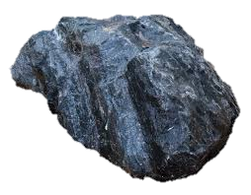
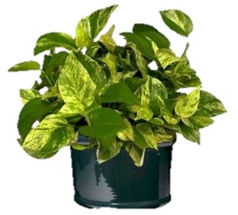
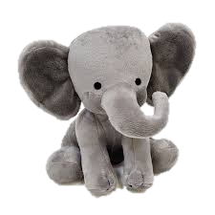

Slide 9
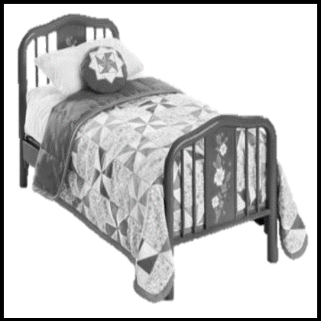

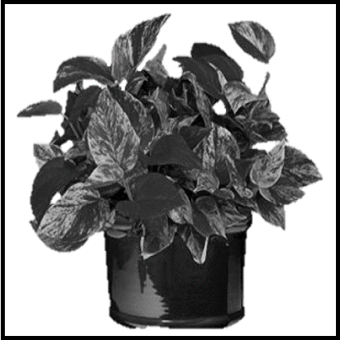
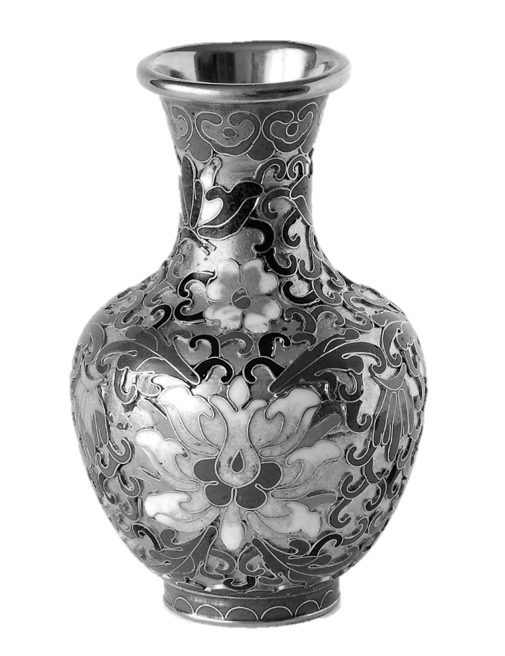

Slide 10

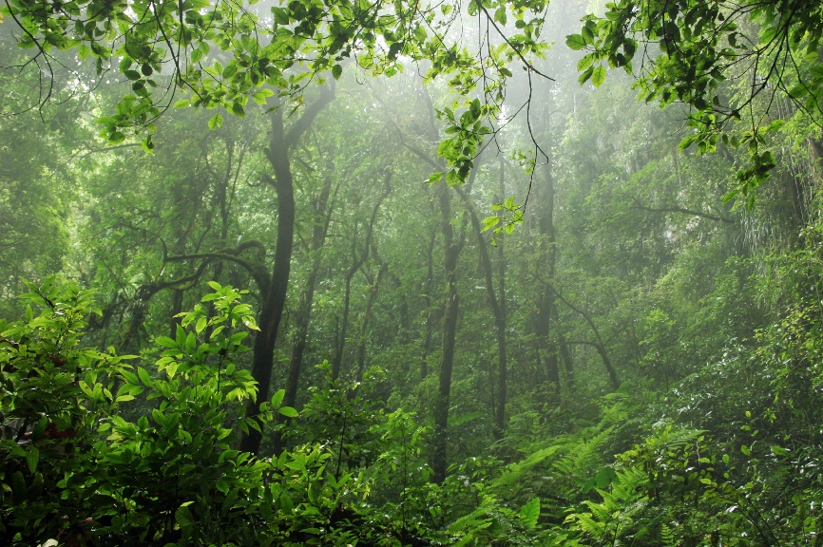





a
c
TS0: 25
TS2: 15
6 | 1 | 1 | 1
1 | 4 | 1 | 1
1 | 1 | 5 | 10
1 | 1 | 3 | 1
7 | 1 | 1 | 1
1 | 3 | 1 | 2
b
TS1: 20
d
6 + 2 + 7 | 4 + 8 + 3 | 5 + 7 + 3 | 10 + 3 + 2
15 | 15 | 15 | 15
1 | 8 | 1 | 3
2 | 1 | 7 | 1
1 | 1 | 1 | 1
5 + 10 + 3 + 2 | 6 + 8 + 3 + 3 | 4 + 2 + 7 + 7
20 | 20 | 20

Slide 11


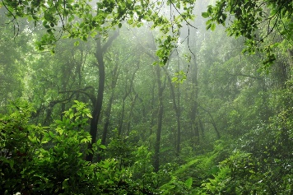
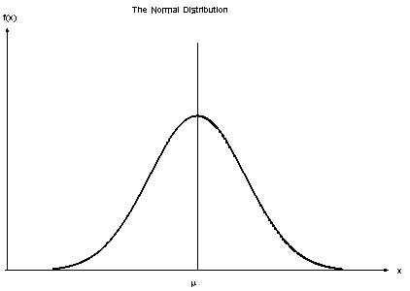
TS1
TS2
TS0
TS1
TS2
1
1
6 | 4 | 5 | 10
2 | 8 | 7 | 3
7 | 3 | 3 | 2
6.25
5
3.75

Slide 12
TS0
TS1
TS2
6 | 4 | 5 | 10
2 | 8 | 7 | 3
7 | 3 | 3 | 2
6.25
5
3.75

Slide 13
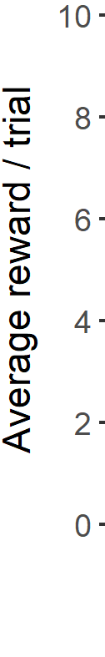
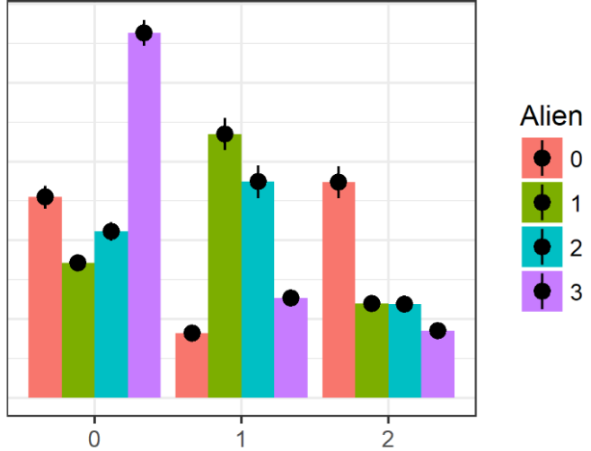
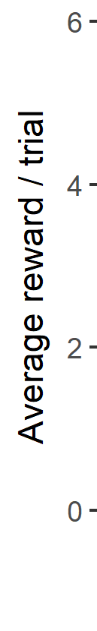
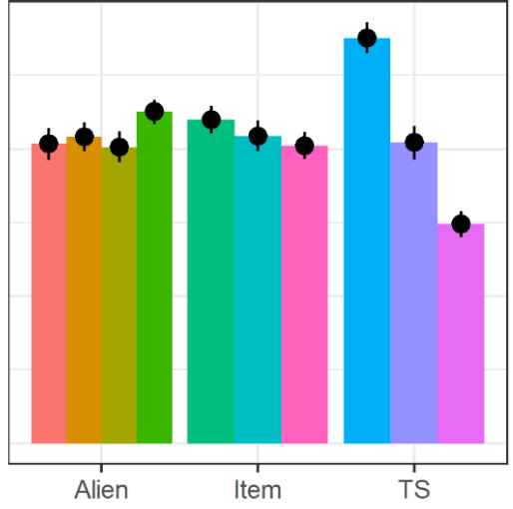
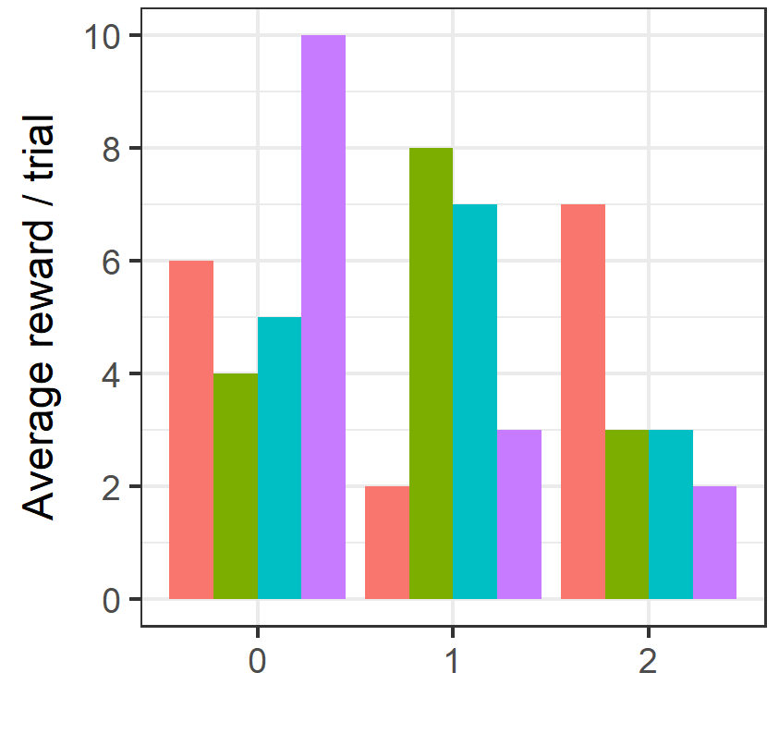
A
B
TS0
TS1
TS2
…
…
…
…
…
6 | 4 | 5 | 10
2 | 8 | 7
6.25
5
3.75

Slide 14
TS1
TS2
TS0
TS1
TS2
6 | 1 | 1 | 1
1 | 4 | 1 | 1
1 | 1 | 5 | 10
1 | 8 | 1 | 3
2 | 1 | 7 | 1
1 | 1 | 1 | 1
1 | 1 | 3 | 1
7 | 1 | 1 | 1
1 | 3 | 1 | 2
6.25
5
3.75

Slide 15
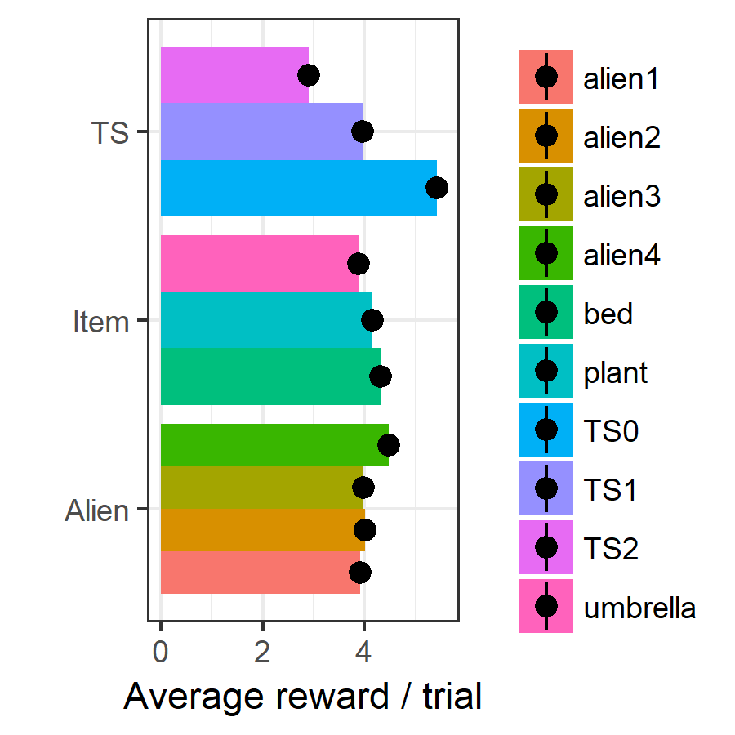


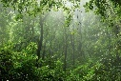
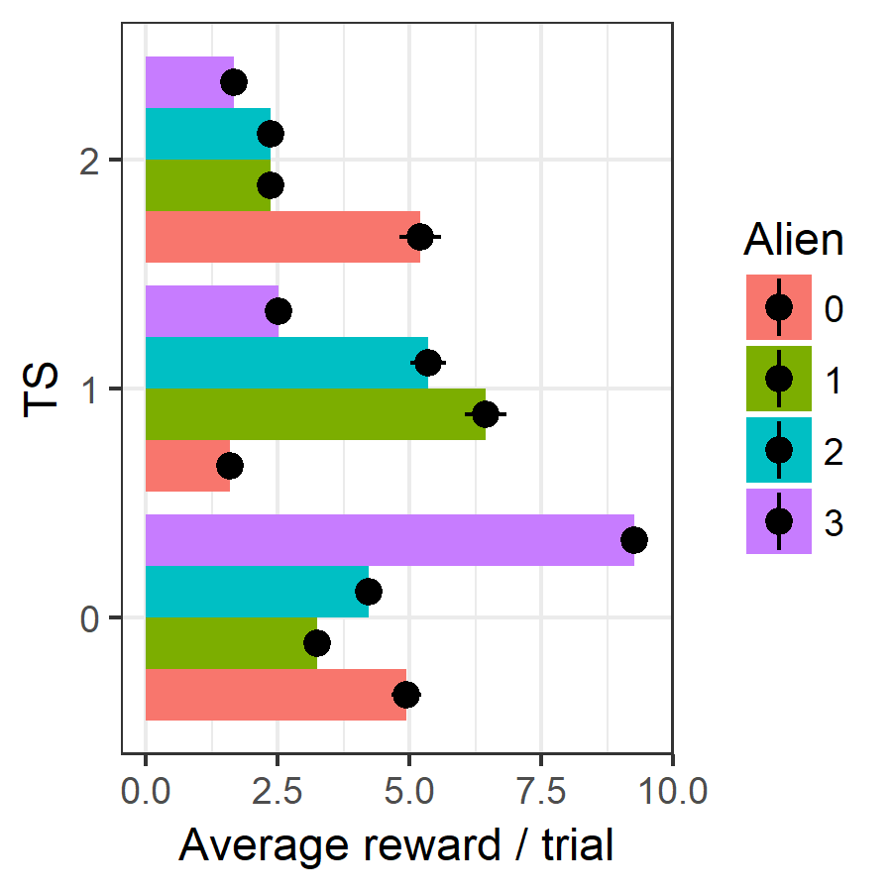
6 + 4 + 5 + 10 | 2 + 8 + 7 + 3 | 7 + 3 + 3 + 2
6.25 | 5 | 3.75
6 + 2 + 7 | 4 + 8 + 3 | 5 + 7 + 3 | 10 + 3 + 2
5 | 5 | 5 | 5
5 + 10 + 3 + 2 | 6 + 8 + 3 + 3 | 4 + 2 + 7 + 7
5 | 5 | 5

Slide 16
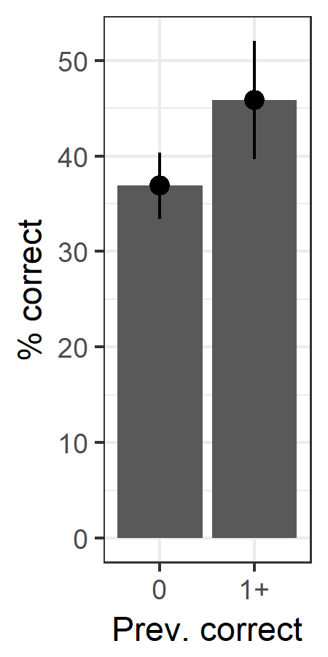
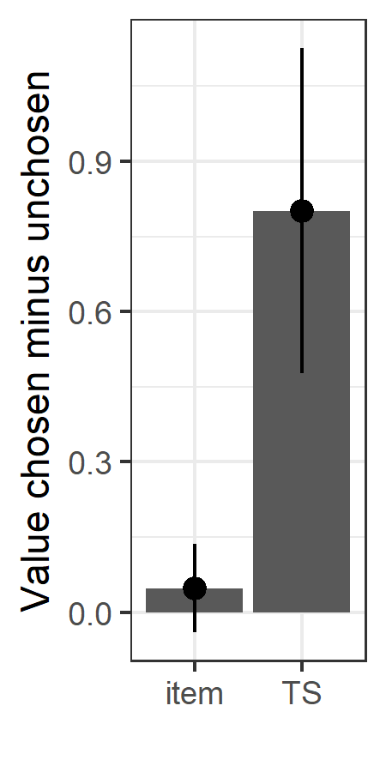
*
*
n.s.

Slide 17
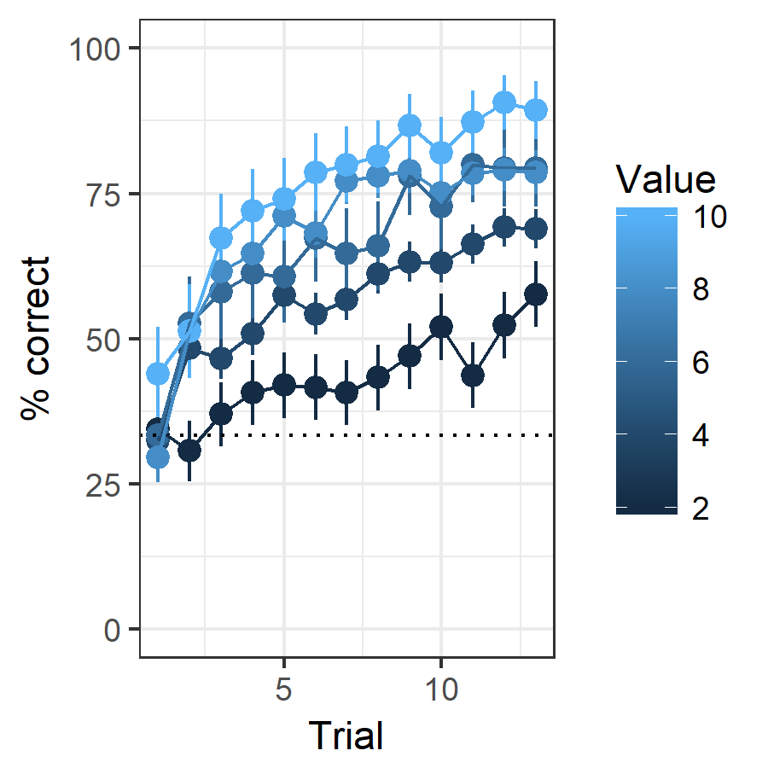
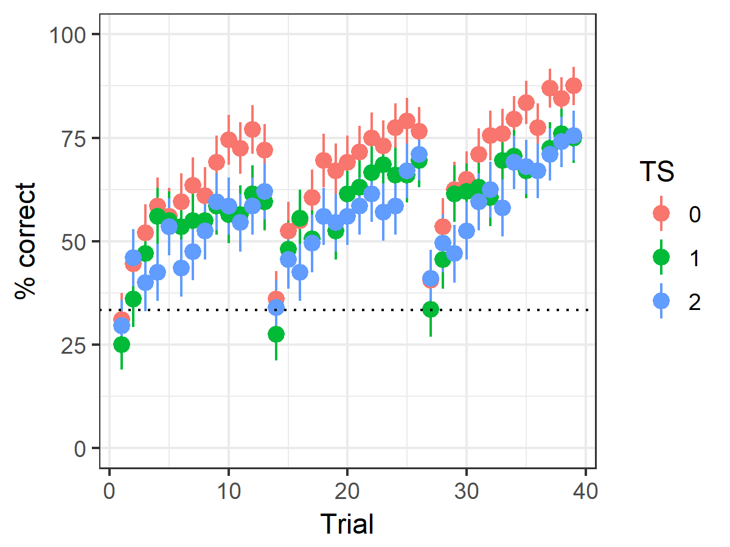
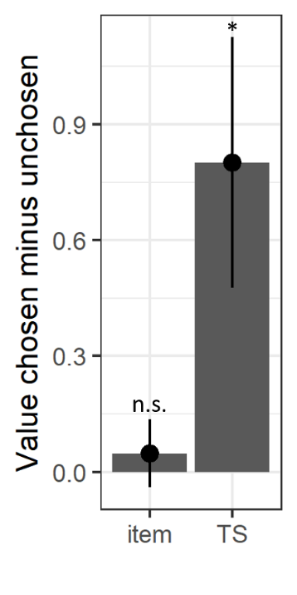
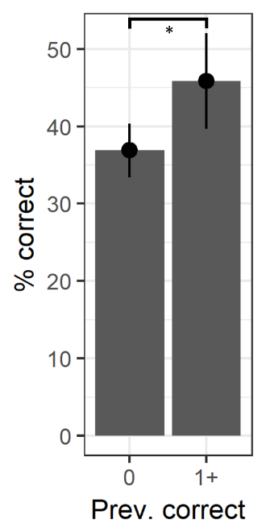
A
B
A
B

